Slide 1
CAB302 Assignment 2 GUI Test
Bryce Rochecouste: n8569053
Liam Dinsdale: n9284281

Slide 2
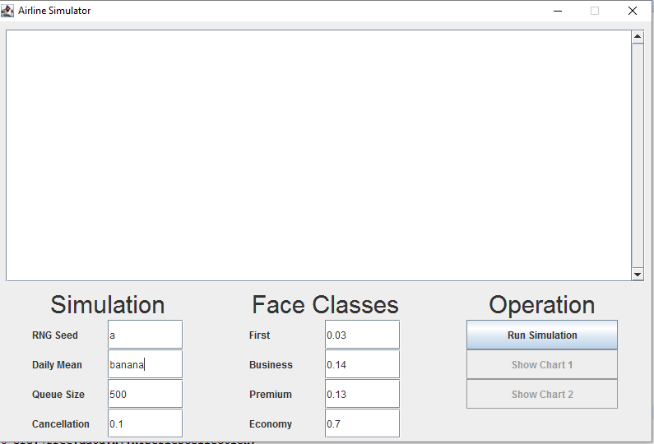
Test 1 input screen shot: invalid parameters

Slide 3
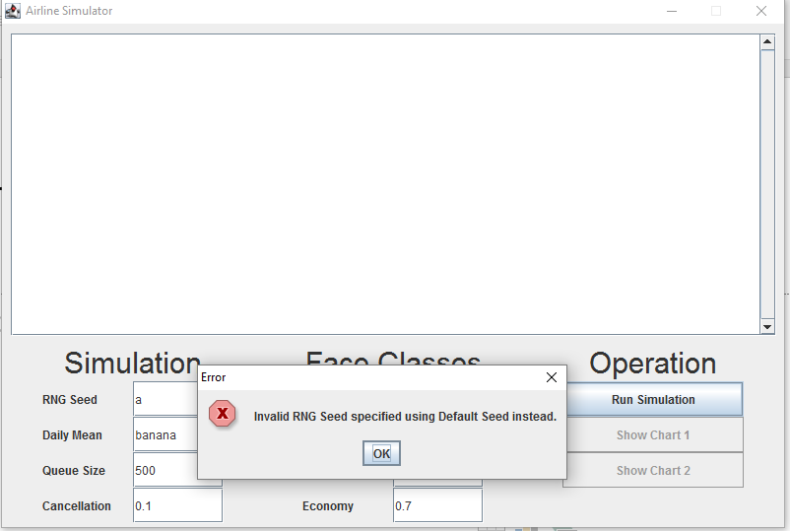
Test 1 Error Screen Shot 1
In both cases the invalid parameters reverted back to Default

Slide 4
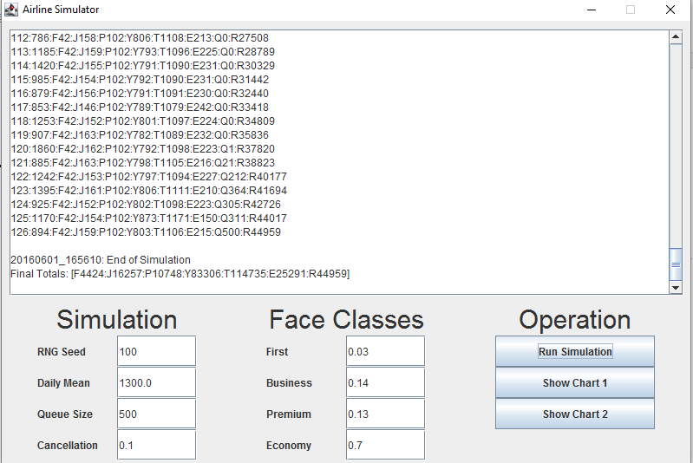
Test 1 input and end result

Slide 5
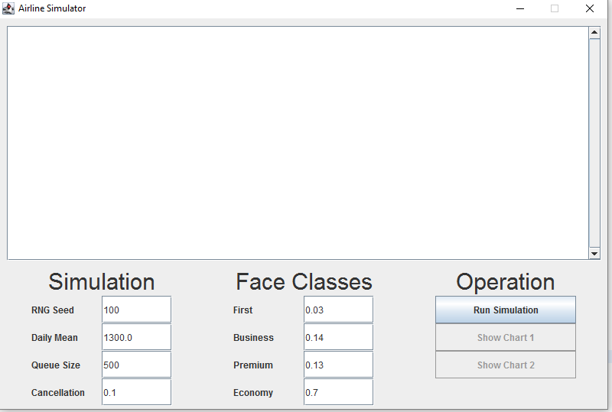
Test 2 Input Default Parameters

Slide 6
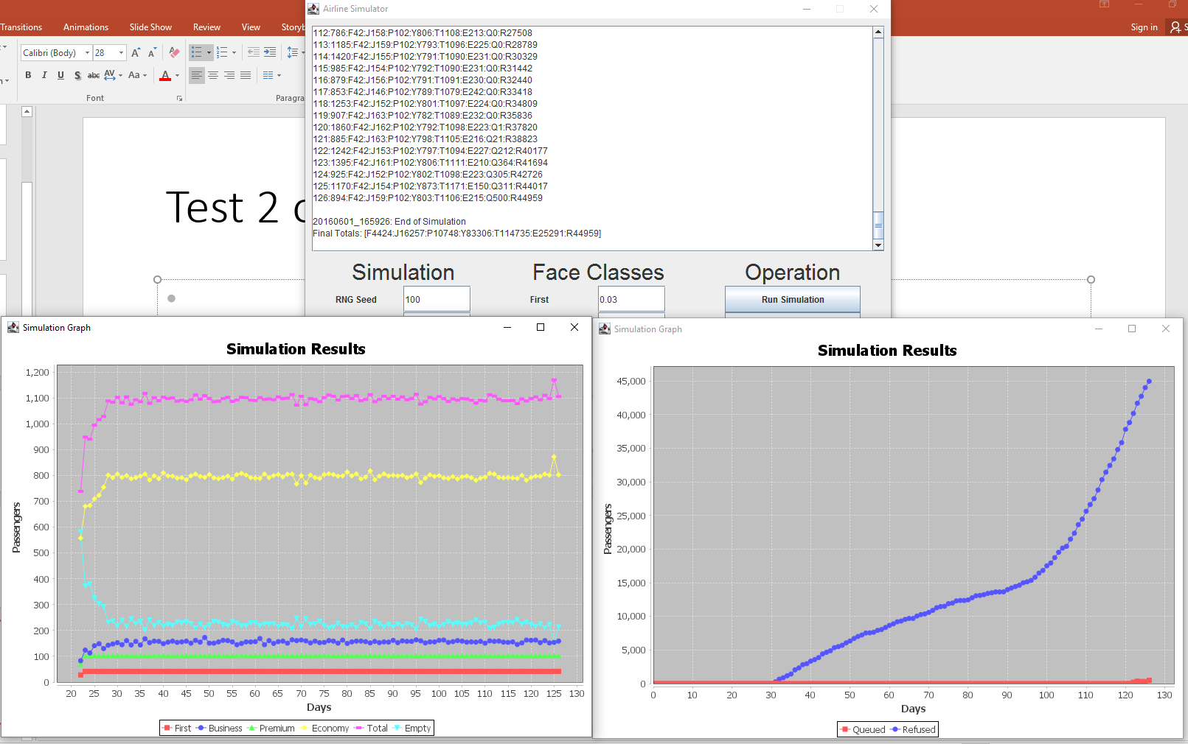
Test 2 output and charts

Slide 7
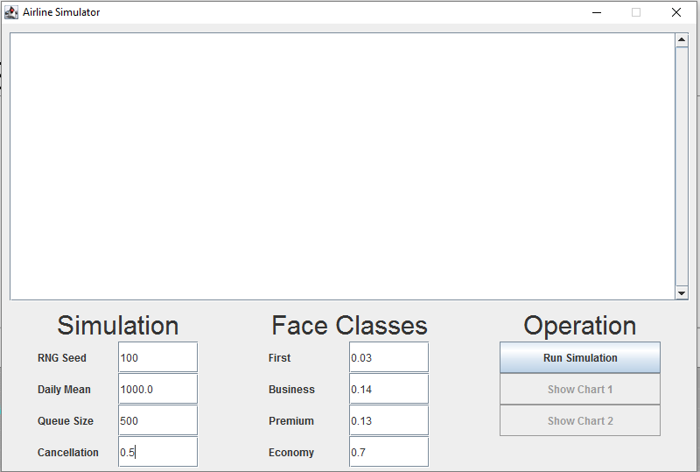
Test 3 Input: cancellation at 50%

Slide 8
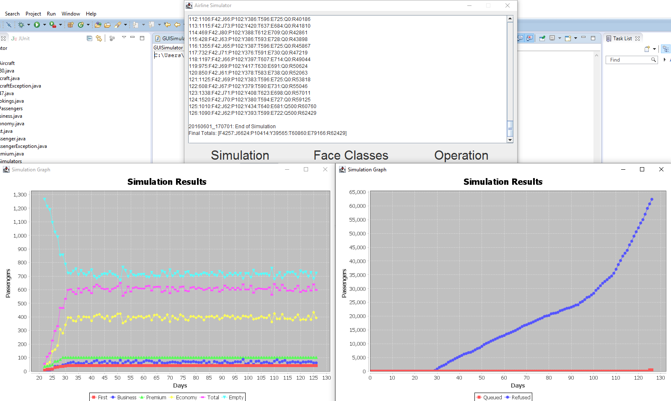
Test 3 Output and Charts

Slide 9
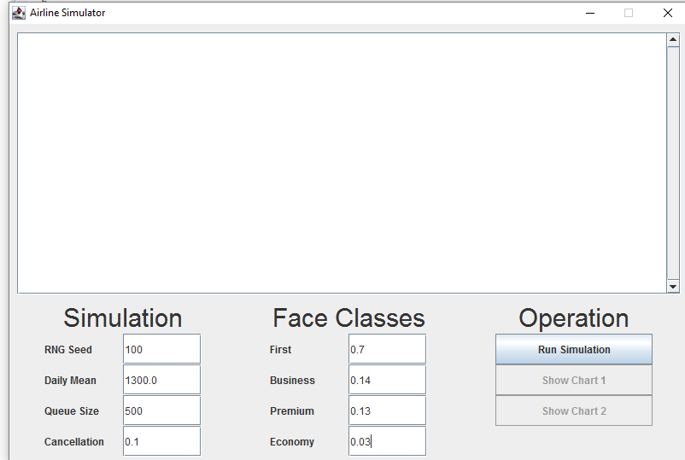
Test 4 Input: first at 70% and Eco at 3%

Slide 10
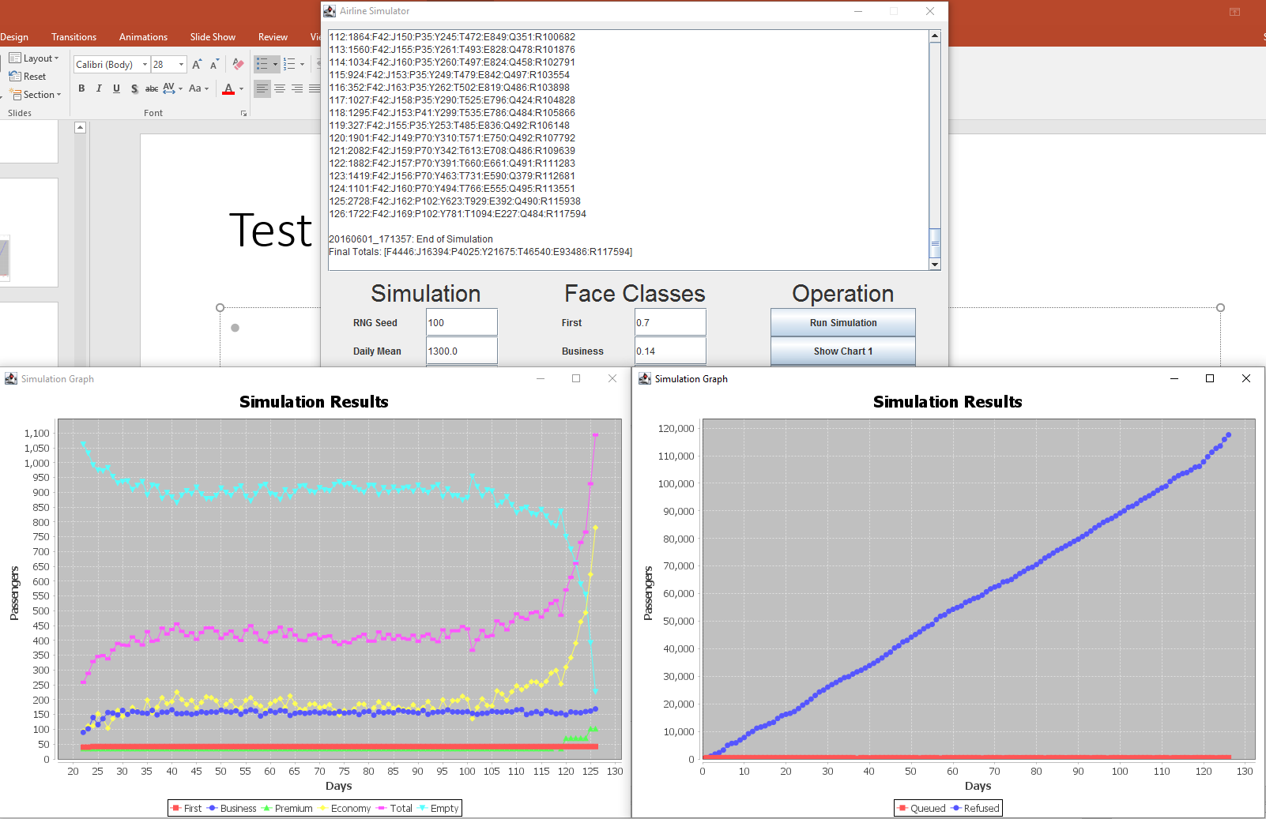
Test 4 output and charts

Slide 11
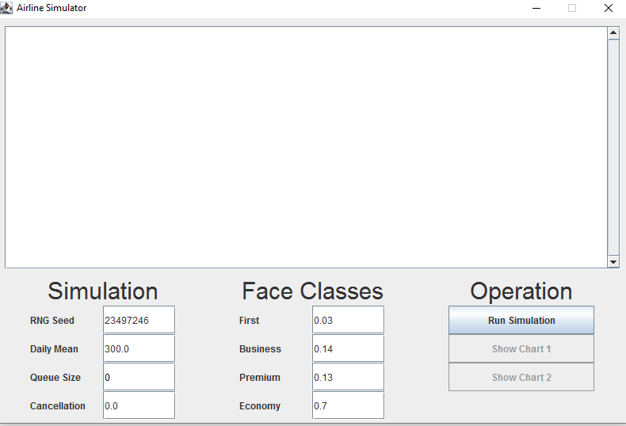
Test 5 Input
Large Integer Seed
Low Daily Mean
Zero Queue
No Cancellation

Slide 12
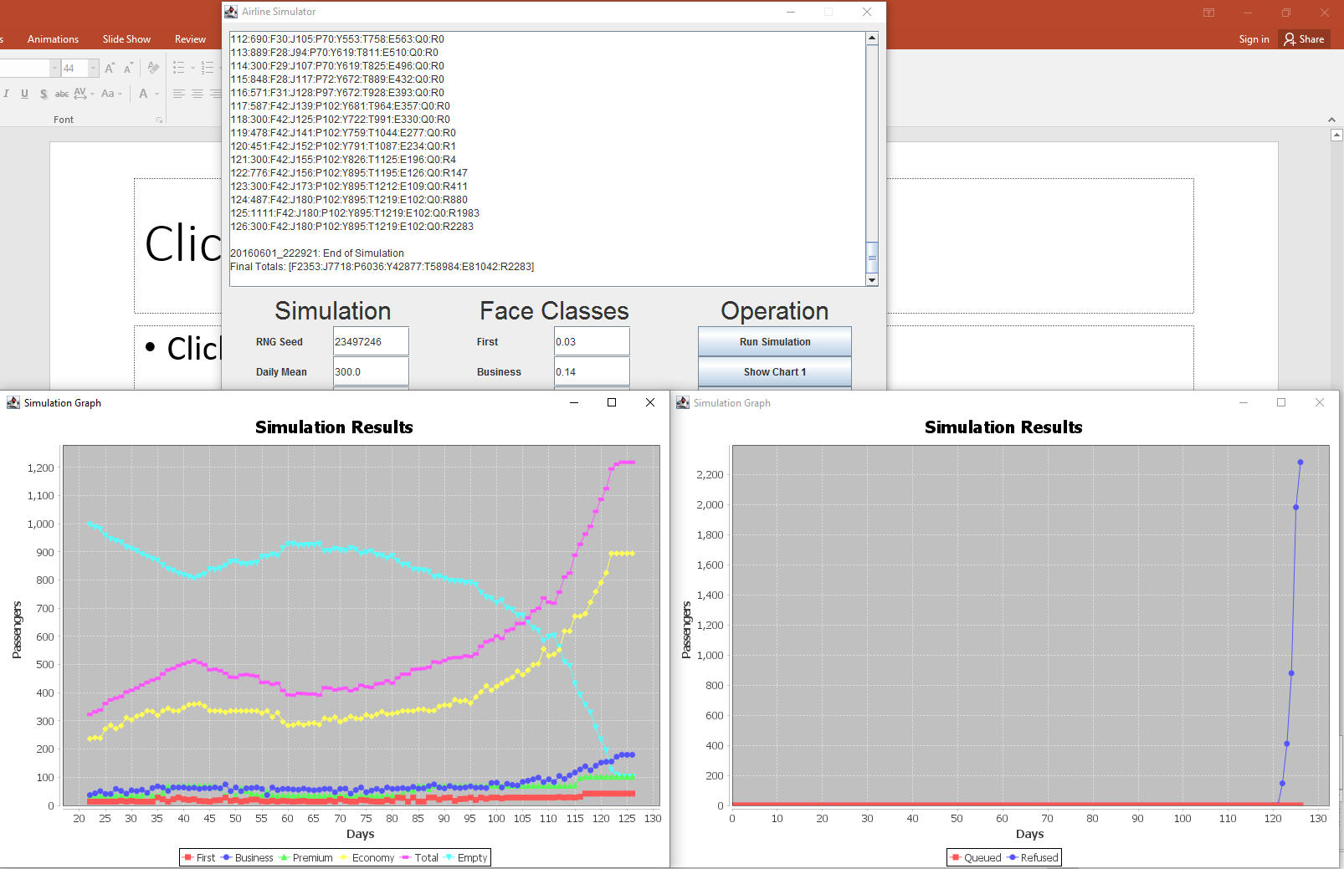
Test 5 output and charts

